Slide 1
CAP476:
Data Communication and Networking
Unit-I
OSI Reference Model

Slide 2
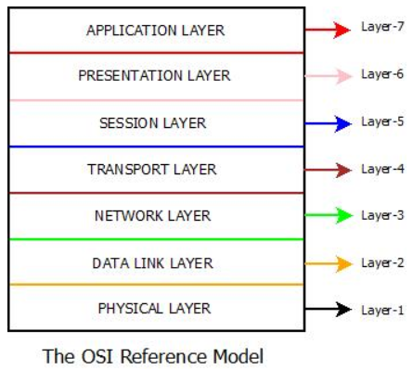

Slide 3
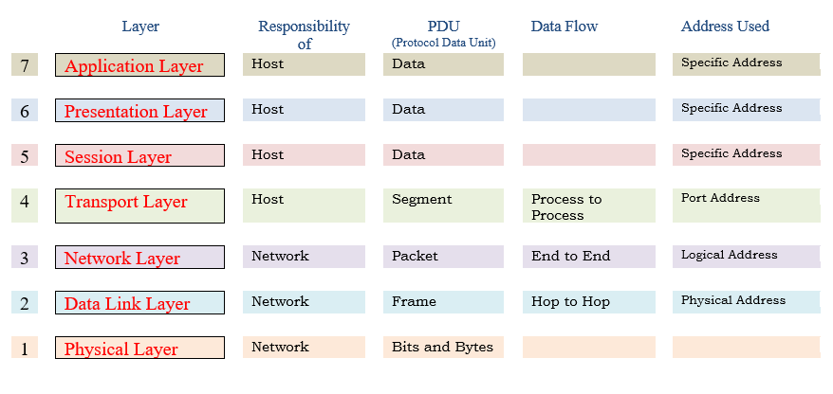

Slide 4
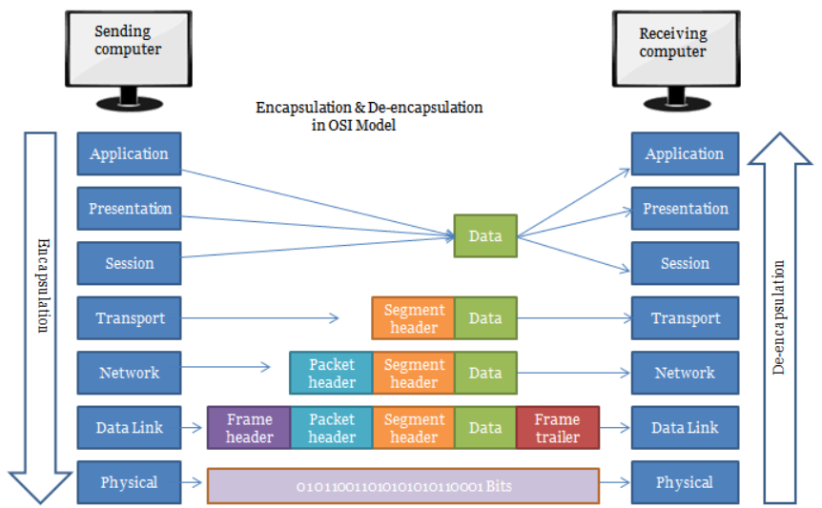

Slide 5
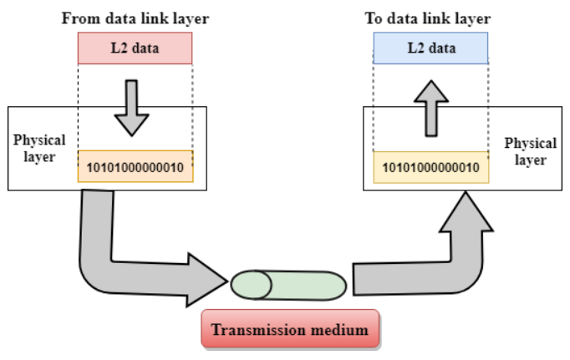
Physical Layer
Lowest layer of OSI model
Transmits raw bits between nodes
Establishes and terminates connections
Defines mechanical and electrical specs
Manages physical topology and signaling

Slide 6
Functions of the Physical Layer
Defines physical device connections
Specifies line configuration methods
Controls data transmission modes
Manages network device topology
Determines signaling type used

Slide 7
Data-Link Layer
Responsible for error-free frame transfer
Defines data format on network
Provides reliable communication between devices
Contains two sublayers:
Logical Link Control (LLC)
Media Access Control (MAC)
Manages flow control and error detection
Controls access to shared media

Slide 8
Functions of Data-Link Layer
Framing: Converts bits into frames with headers and trailers
Physical Addressing: Adds hardware addresses to frames
Flow Control: Manages data rate to prevent congestion
Error Control: Detects and corrects errors using CRC
Access Control: Determines device control on shared media

Slide 9
Network Layer
Manages device addressing and location
Determines best path for data delivery
Responsible for routing and forwarding packets
Utilizes routers as layer 3 devices
Implements protocols like IP and IPv6

Slide 10
Functions of Network Layer
Internetworking: Provides logical connections between devices
Addressing: Adds source and destination addresses in frame headers
Routing: Determines the best optimal path for data transfer
Packetizing: Converts segments from upper layer into packets using IP
Device location tracking: Manages device addressing and location on network

Slide 11
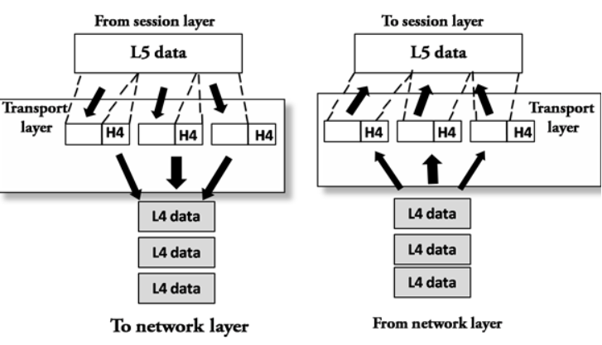
Transport Layer
Facilitates end-to-end data delivery
Provides reliable and/or unreliable data transfer
Supports connection-oriented (TCP) and connectionless (UDP) services
Performs segmentation and reassembly of data
Manages flow control and error control

Slide 12
Functions of Transport Layer
Provides end-to-end delivery
Segments and reassembles data
Offers connection-oriented and connectionless services
Controls data flow
Implements error detection & recovery

Slide 13
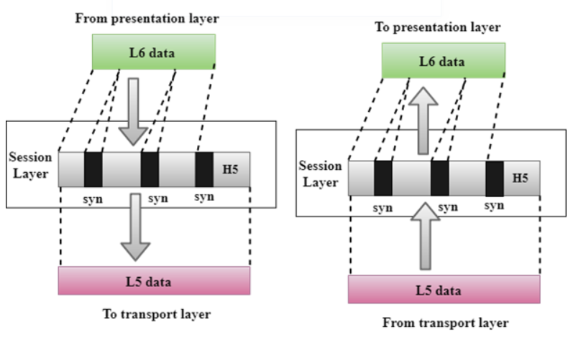
Session Layer
Establishes and maintains sessions
Manages dialog control (half/full duplex)
Synchronizes data exchange with checkpoints
Provides recovery from data transmission errors
Ensures controlled interaction between devices

Slide 14
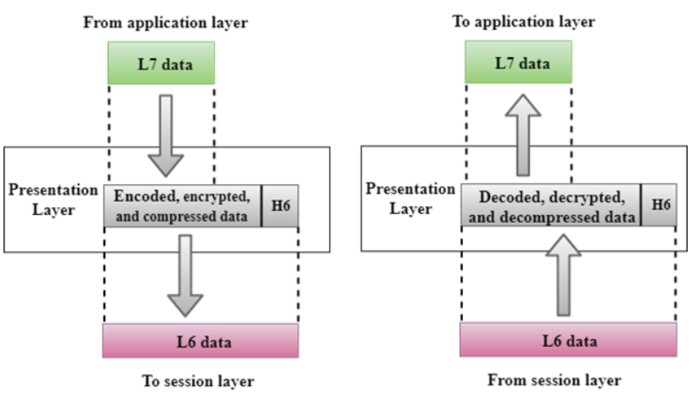
Presentation Layer
Translates data formats between systems
Handles data syntax and semantics
Performs data encryption for privacy
Conducts data compression to reduce size
Ensures interoperability between diverse systems

Slide 15
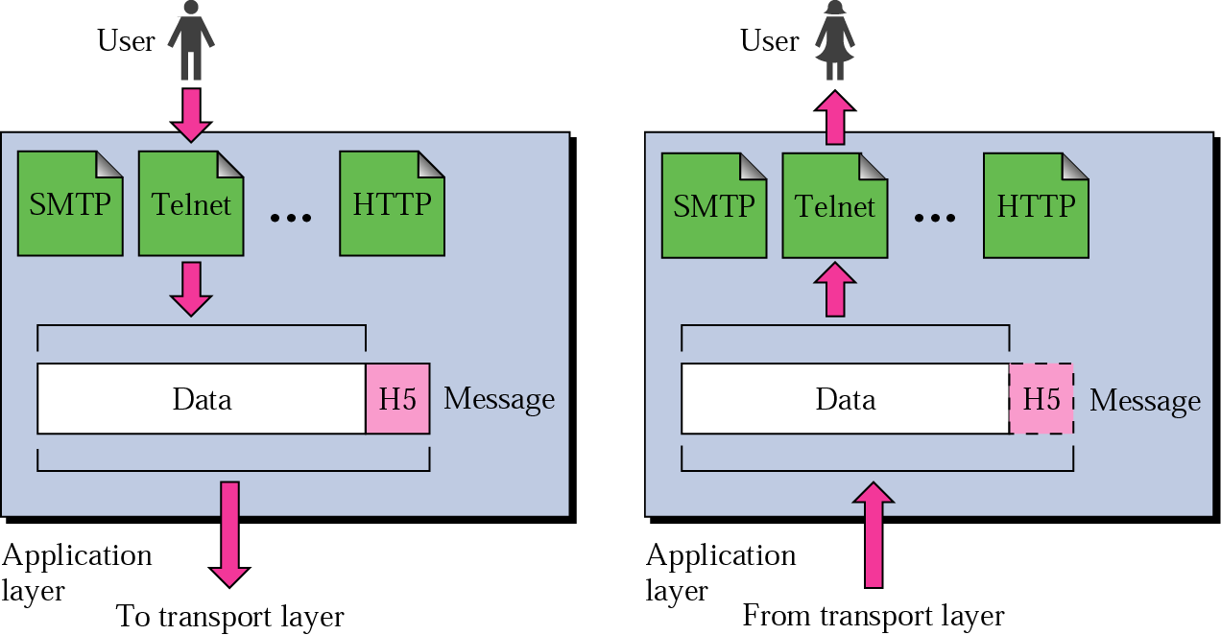
Application Layer
Provides interface for user applications
Manages file transfer, access, and management
Facilitates email services (SMTP)
Handles directory services for distributed databases
Supports protocols like HTTP, FTP, DNS, TELNET

Slide 16
THANK YOU

